Slide 1




Bank Network Design
By:
Ratnangsu Chatterjee
Tanya Jayanti
Harsh Tiwari

Slide 2
S No. | Report Contents | Slide No.
1. | Project Abstract and Introduction | 3
2. | Motivation | 4
3. | Design Architecture | 5
4. | Campus Diagram | 6
5. | Network Requirement and Analysis | 7
6. | Network and System integration Methodology | 9
7. | Bill of Materials | 14
8. | Conclusion | 15

Slide 3

Project Abstract and Introduction
During the last decade, the importance of computer networks and telecommunications has grown tremendously.A computer network is a set of computers sharing resources located on or provided by network nodes. These interconnections are made up of telecommunication network technologies, based on physically wired, optical, and wireless radio-frequency methods that may be arranged in a variety of network topologies.
In this project, we are designing computer network for a bank. The initiative steps were taken by the American and British banks. Computers help bankers keep a record of and verify financial records much quicker.
The general aim of this project is to simulate a banking network which is secure and easy to use. The computers in a bank will be able to communicate with each other to form a network to exchange information regarding customer accounts, transactions etc. The project is being implemented through the Cisco Packet Tracer software.

Slide 4
MOTIVATION
The word “digital” is very significant in today’s world, with an increase in the development of technology the entire world is moving towards the digital era. Going wireless plays an important role in this digitalization. The wireless network makes the connection easy with a reduction in the use of wires or cables. A wired connection makes it difficult to keep track of all the devices and to manage the cable connection, which is not only chaotic but also challenging to handle.
Networking is a vast concept and being a part of contributing to the design of safe networking in a bank is a task we would like to accomplish. I believe my team has the capability and experience to deliver this and ensure that the network is functional properly and can be used with ease.

Slide 5
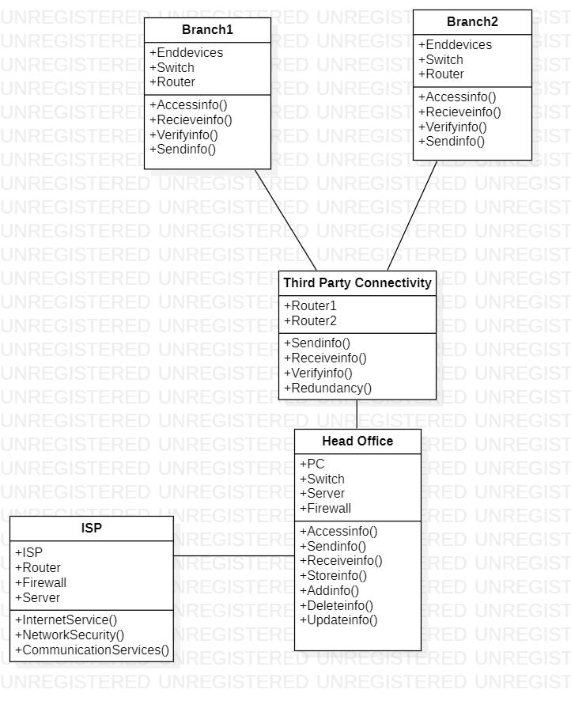
Design Architecture

Slide 6
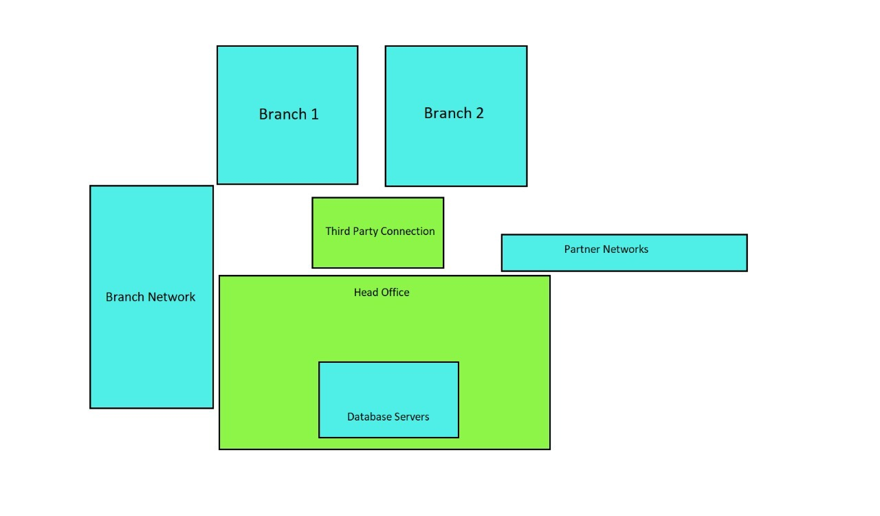
Campus Diagram

Slide 7
Network Requirement Analysis:
This bank network consists of the following devices:
1) Router:
• 1941:
The Cisco 1941 Integrated Services Router (ISR) delivers highly secure data, mobility, and application services. Key features include: 2 integrated 10/100/1000 Ethernet ports. 2 enhanced High-Speed WAN Interface Card slots that can host 2 single wide or 1 double wide and 1 single wide HWIC.
• 1841(x4):
The Cisco 1841 router features secure, fast, and high-quality delivery of multiple, concurrentservices for small-to-medium-sized businesses and small enterprise branch offices. The Cisco 1841 router offers embedded hardware-based encryption enabled by an optional Cisco IOS Software security image.
2) Switches:
• Cisco Catalyst 2960 Series Switches with LAN Lite software are fixed-configuration, standalone switches that provide desktop Fast Ethernet connectivity for entry-level wiring closet and small branch-office networks.

Slide 8
3) PCs:
A personal computer (PC) is a multi-purpose computer whose size, capabilities, and price make it feasible for individual use. Personal computers are intended to be operated directly by an end user, rather than by a computer expert or technician.
4) Servers
5) Laptops

Slide 9
Network and system integration methodology
The most common integration process is the Application Programming Interface (API). While there are several API subcategories, including public, private, and partners, they all utilize application integration. By establishing these interconnections using common code language, systems can transmit data seamlessly throughout solutions.

Slide 10
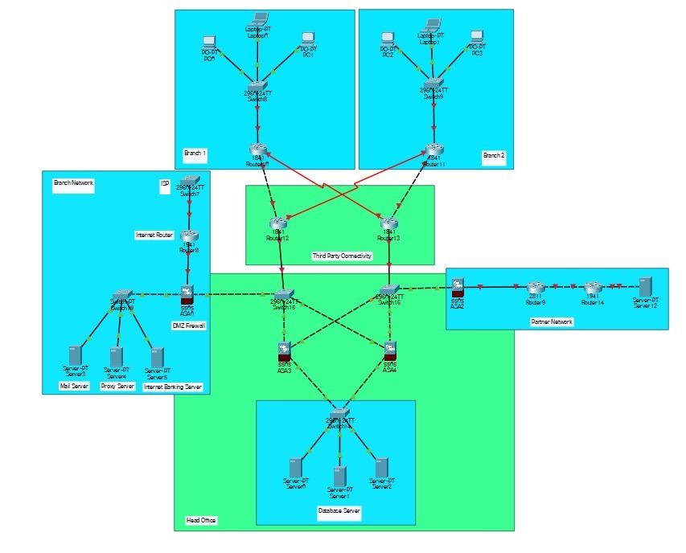
Network Diagram

Slide 11
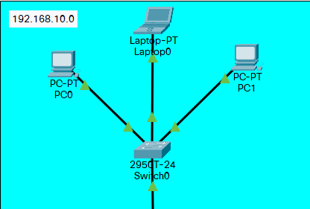
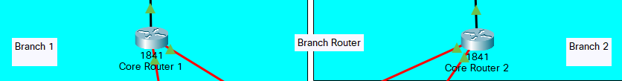
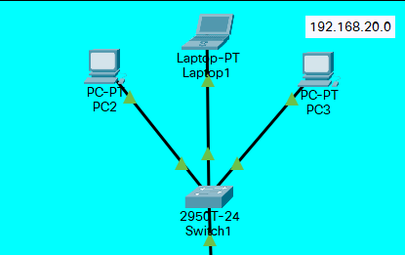
Branch Configuration
IP Address:192.168.10.2
192.168.10.3
192.168.10.4
IP Address:192.168.20.2
192.168.20.3
192.168.20.4

Slide 12
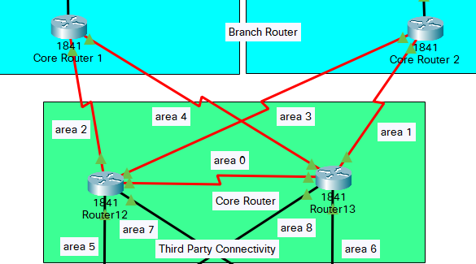
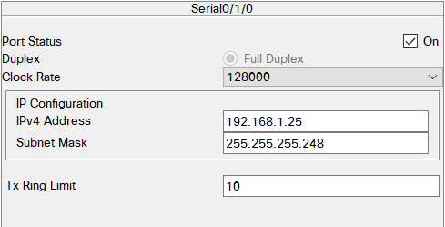
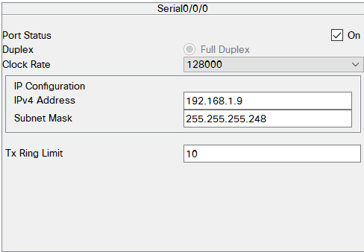
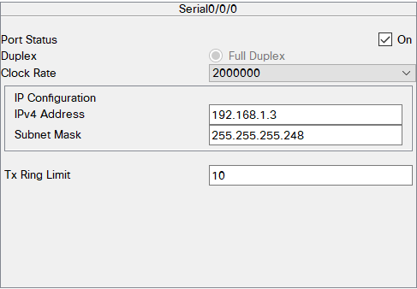
Core Router
Router Configured using Multi Area OSPF Protocol

Slide 13
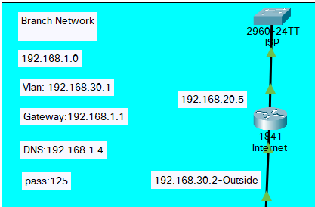
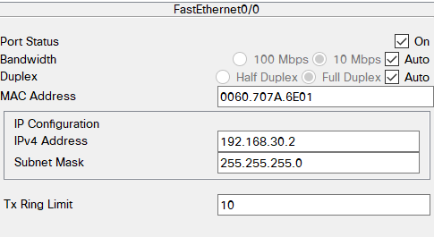
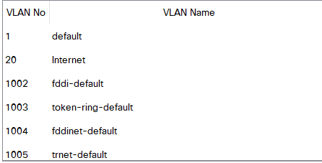
ISP
ISP switch is used to create VLAN and the router connects it to the rest of the servers through a firewall

Slide 14
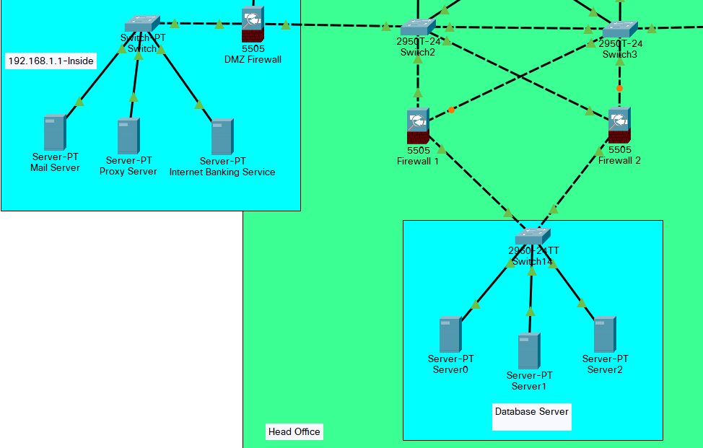
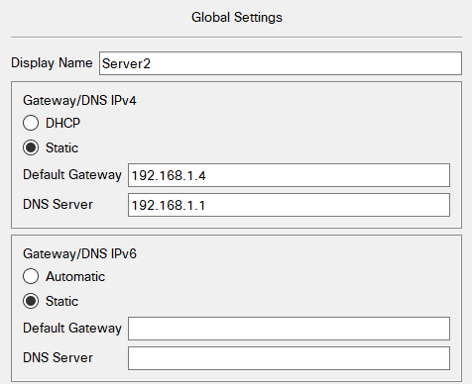
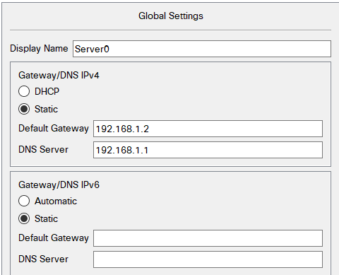
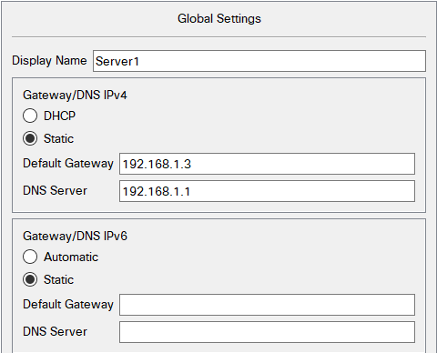
Head Office
Head Office to store,update and remove reduncdancies using servers and switch to connect them to branches and ISP

Slide 15
Bill Of Materials
Tools | Quantity | Cost(per piece) | Total Cost
PCs | 6 | 74,990 | 4,49,490
Router | 7 | 2829 | 19,980
Firewall | 4 | 51000 | 2,60,060
Switches(layer 3) | 7 | 164501 | 11,51,503
Multi-layer switch | 5 | 20119 | 1,00,595
Copper cross over | 7 | 810 | 5670
Server | 6 | 60000 | 3,60,000

Slide 16
Conclusion
We started our discussion with the word “digitalization” and in order to achieve it, we aimed to start with an educational institute, and finally, we designed a network for a bank, which is wireless. As we mentioned, mobility and efficiency are the key aspects of wireless networks, which were our main goal, and hence, we decided to shift to a wireless network instead of a wired one, making our network clean and less chaotic.
In this project, we designed a Bank Network using Cisco Packet Tracer that uses a networking topology implemented using servers, routers, switches, and end devices in multiple area networks. We have covered all the necessary features that are required for a network to function properly. We have included a DNS server and a web server for establishing a smooth communication system between different areas of our network and specifically for the communication between students and teachers. We have included an email server to facilitate intra university communication through emails within the domain.

